Slide 1

COVID - 19 DETECTION FROM COUGH AUDIO ANALYSIS USING
MEL FREQUENCY CEPSTRAL COEFFICIENTS
BY:
Abhishek Verma
Research Intern
SSN College of Engineering, Kalavakkam
GUIDE :
Dr. A. Shahina
Professor, Department of IT
SSN College of Engineering, Kalavakkam

Slide 2

Covid-19: Some Facts
The Severe Acute Respiratory Syndrome Coronavirus 2 (SARS-CoV-2) is a viral disease that causes serious pneumonia and impacts our different body parts from mild to severe depending on patient’s immune system.
The need for COVID-19 testing kits has increased, and many of the developing countries in the world are facing a shortage of testing kits as new cases are increasing day by day.

Slide 3
Objectives
To detect Covid-19 cases by analysing the Cough Audios of the patients using Neural Networks and Cepstral Coefficients.
To give a boolean verdict (Covid or Not Covid) from the audio sample delivered by the user.

Slide 4
Motivation
Detecting possible COVID-19 without going through complex medical tests such as RT-PCR (Reverse Transcription–Polymerase Chain Reaction) and X-Rays will help in providing ease of diagnoses.
Subject will not have to travel to a medical facility and the testing can be done at home through an Application Interface preventing the subject from exposure to the outdoor and possible hotspots for virus transmission.

Slide 5
Datasets
Cough Audio Recordings: 166 Files
in .wav format
https://www.kaggle.com/himanshu007121/coughclassifier-trial
Files with Audio Labels as Covid and Not Covid
in .csv format
https://www.kaggle.com/himanshu007121/coughclassifier-trial

Slide 6
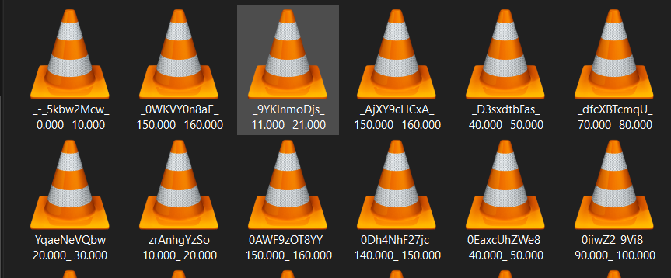
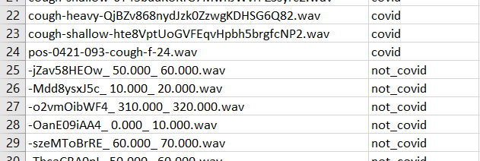
Datasets
Cough Audio Recordings: 166 Files
Files with Audio Labels as Covid and Not Covid

Slide 7
Work: Experiment 1
Exploratory Data Analysis using MFCCs and ANN
Covid
or
Not Covid
Cough
Audio
ANN

Slide 8
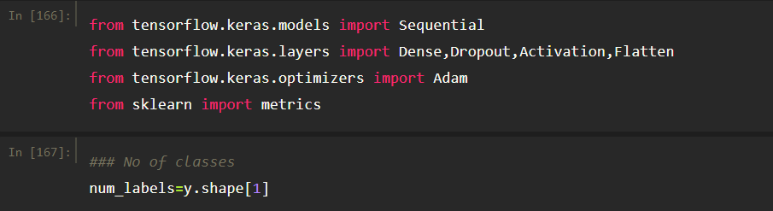
Work: Experiment 1
Model Creation

Slide 9
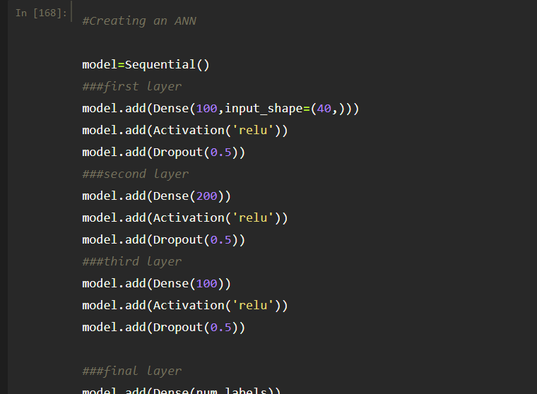
Work: Experiment 1

Slide 10
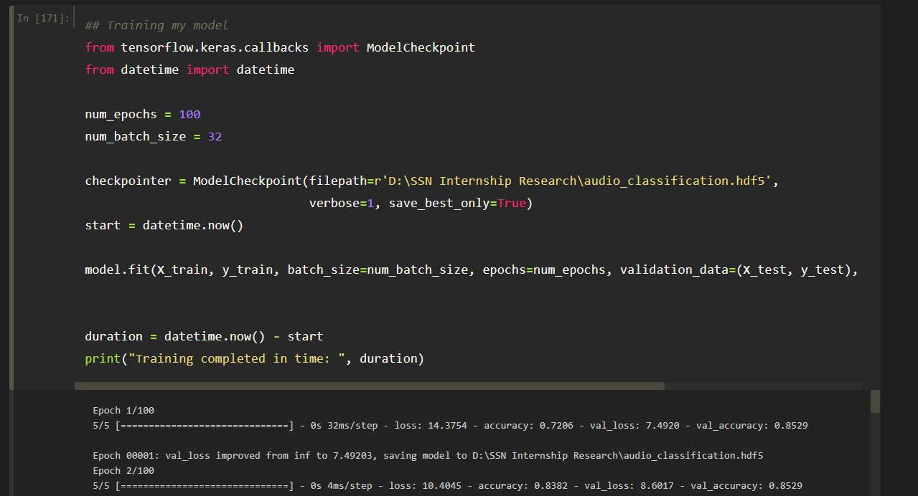
Work: Experiment 1

Slide 11
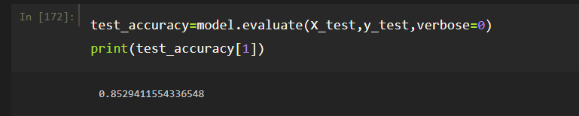
Work: Experiment 1
Model Accuracy

Slide 12
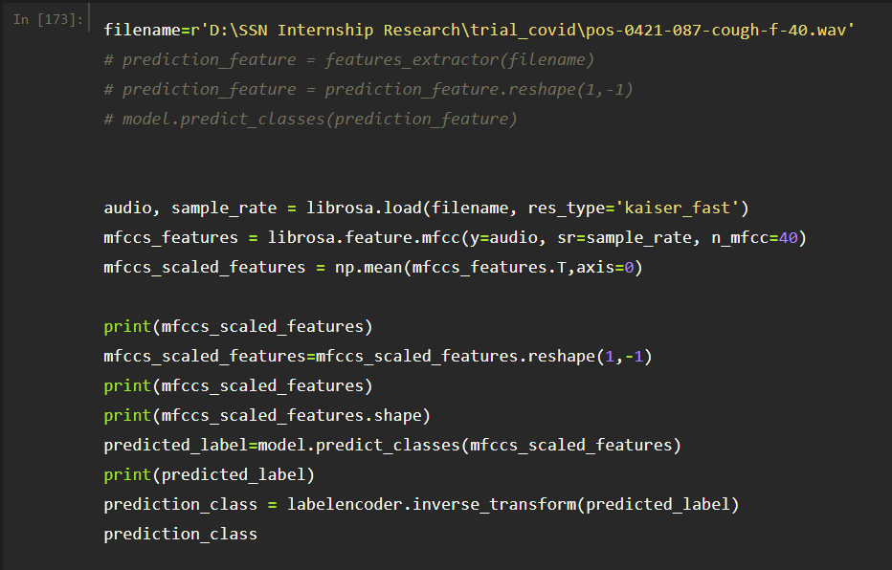
Work: Experiment 1
Testing

Slide 13
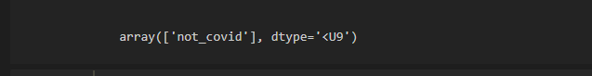
Work: Experiment 1
Testing

Slide 14
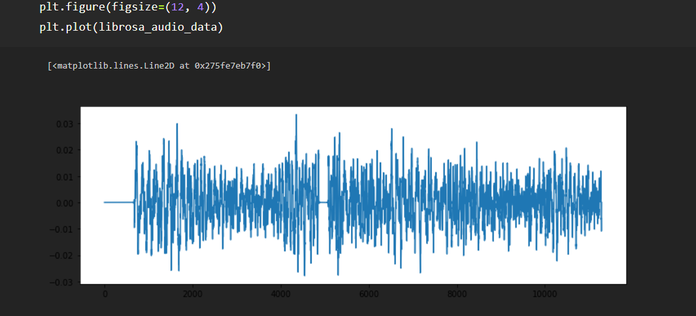
Experiment 1
Visualizations for an Audio File

Slide 15
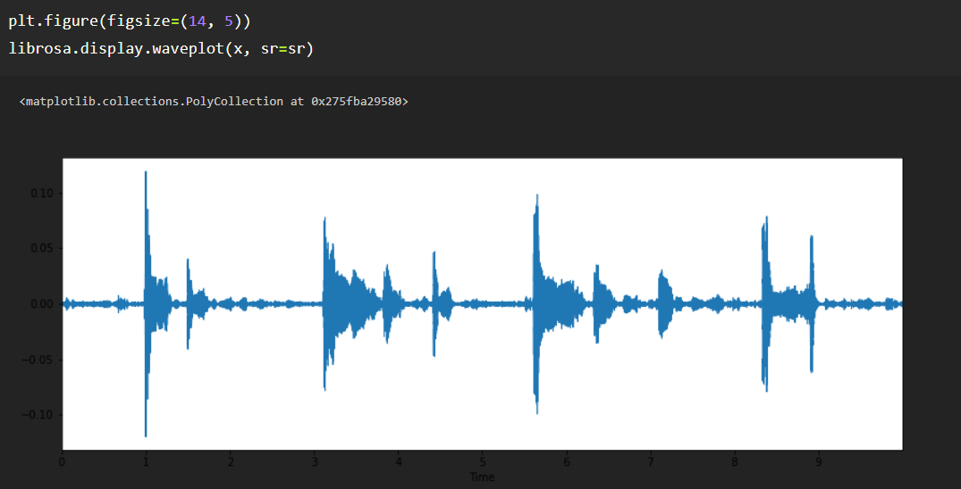
Experiment 1
Visualizations for an Audio File

Slide 16
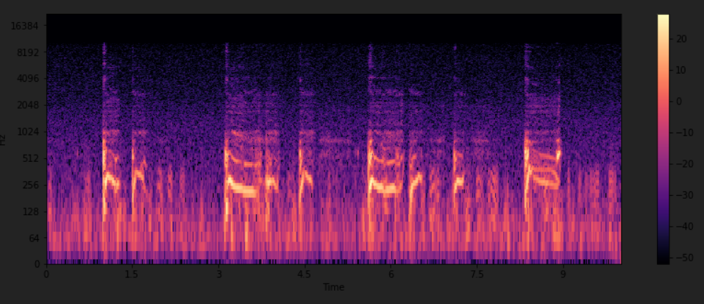
Experiment 1
Visualizations for an Audio File

Slide 17
Proposed Work
Experiment 2:
Implementation with Weighted Linear Prediction Cepstral Coefficient (WLPCC) and CNN
Experiment 3:
Implementation through Spectrograms

